Slide 1
Data Science Bootcamp
Midterm Project:
What are the attributes of NYC Neighborhoods?
Presented by Michael Boddy & Siu Kei Cheung @18 Mar 2022

Slide 2
Project Phases
1) Data gathering
2) Data cleanup
3) Modelling
4) Data analysis

Slide 3
Data Sources
NYC Neighborhood spatial information
City Realty average housing prices Manhattan/Brooklyn July 2020
Zumber median housing prices for Manhattan/Brooklyn Feb 2021
Google (to fill in missing housing price data)
NYC OPEN data
Crime rate
Population
Foursquare
Schools, hospitals, banks, bus stations, restaurants, bars

Slide 4
Neighborhood Segmentation
Rent Prices (Studio)
Crime Rate
Rent Prices (1 bed)
No of Schools
Features
Rent Prices (2 beds)
No of Hospitals
Population
No of Bus Stations

Slide 5
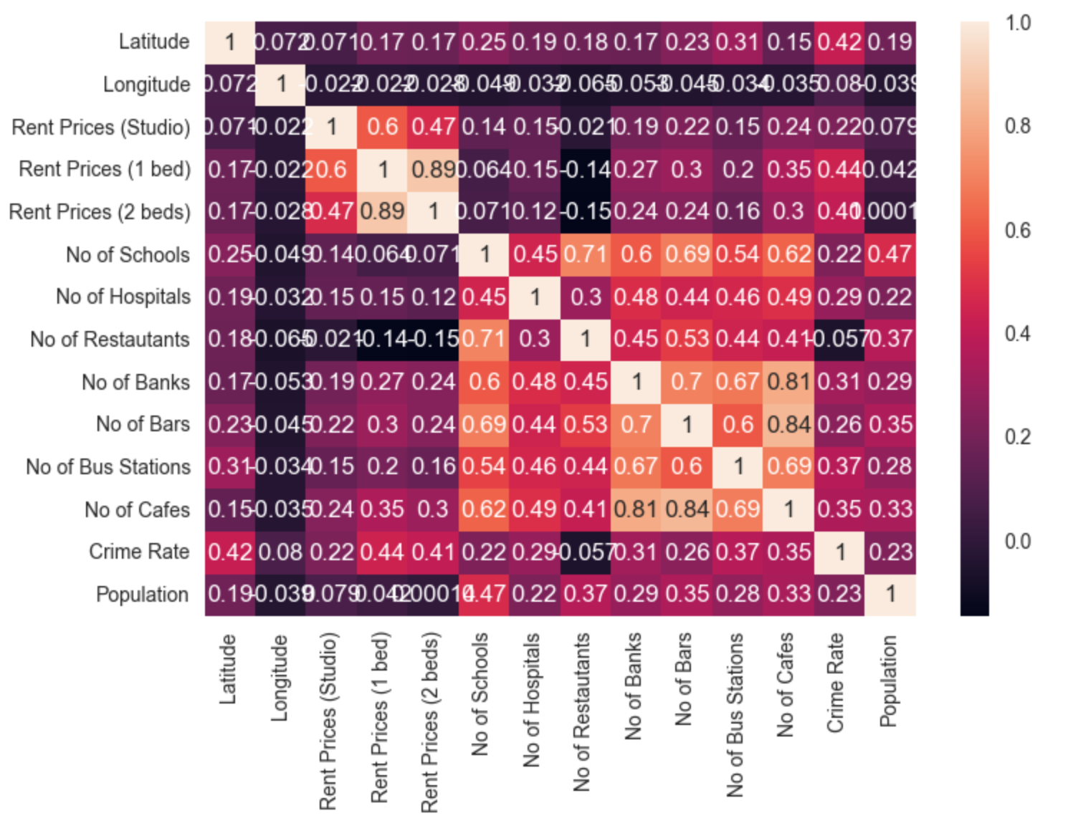
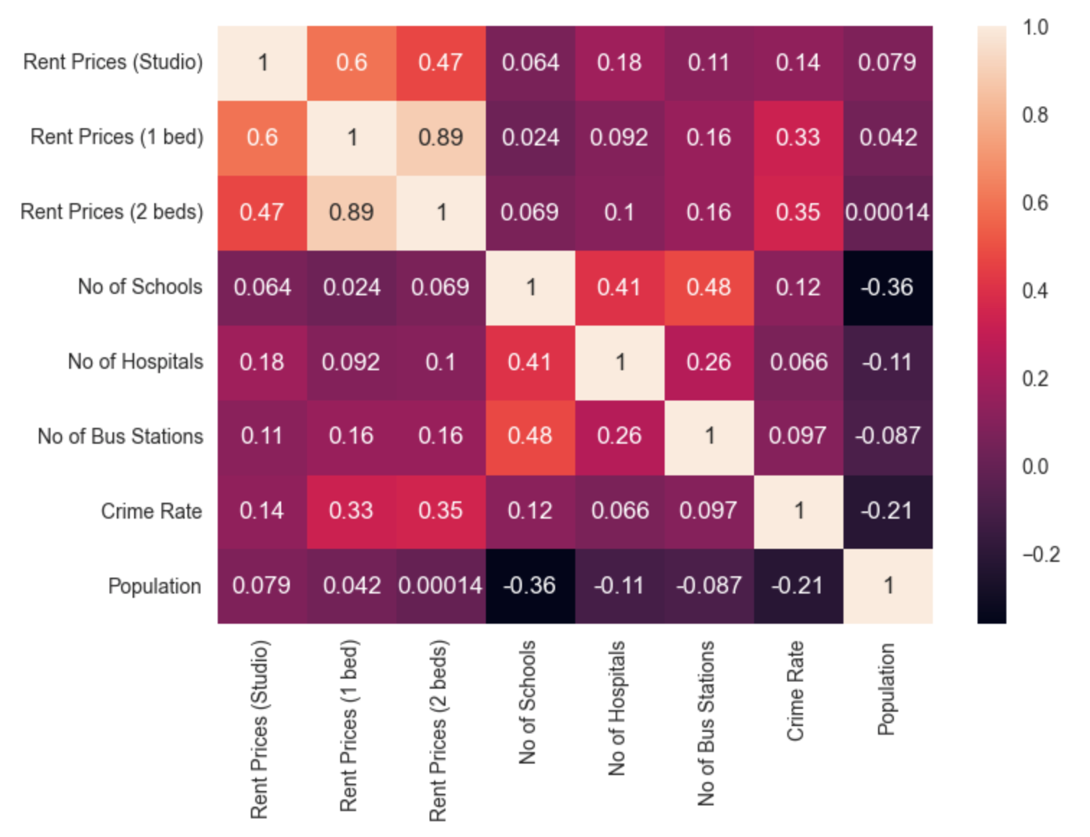
Neighborhood Segmentation Features Correlation
Early Version
Final Version

Slide 6
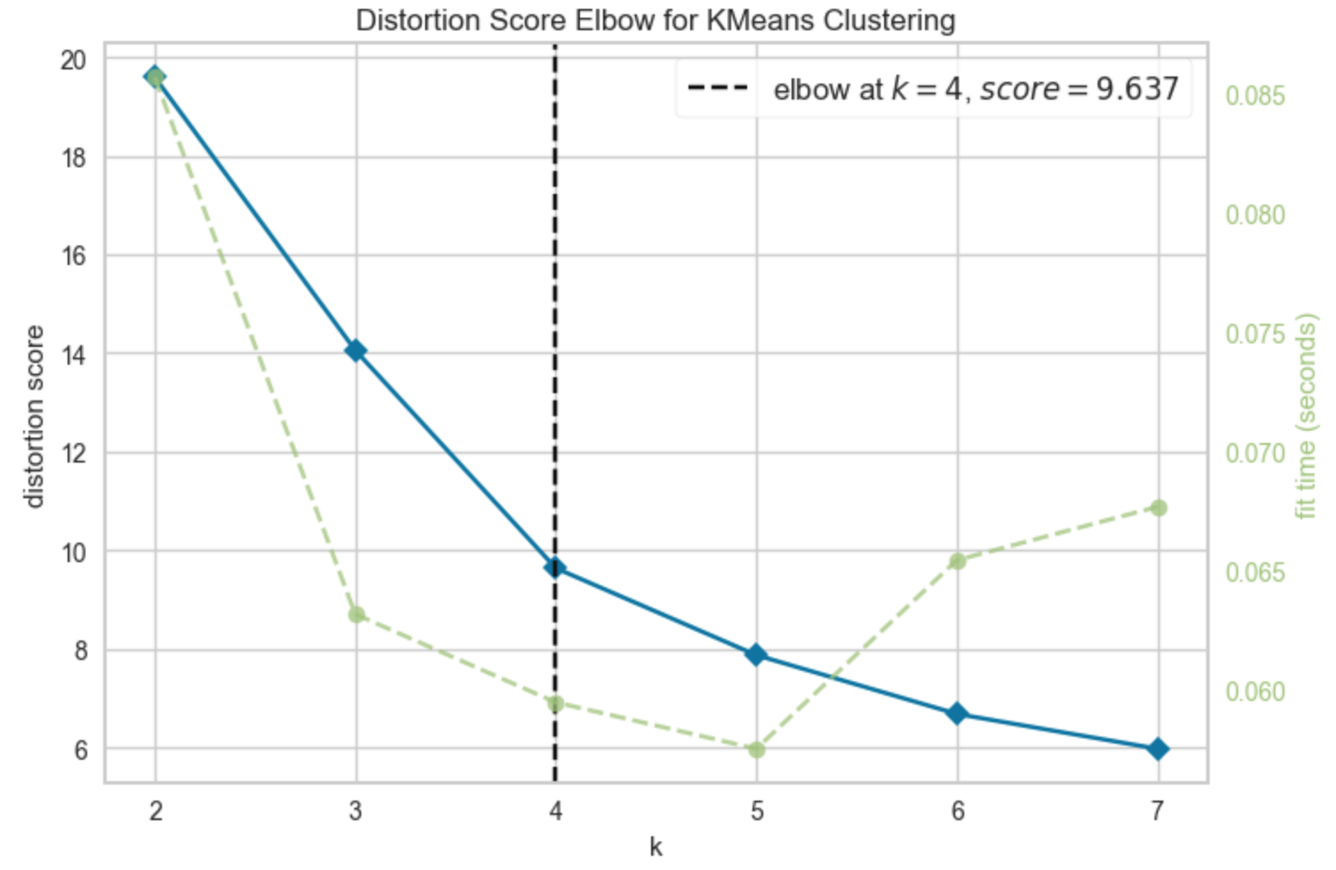
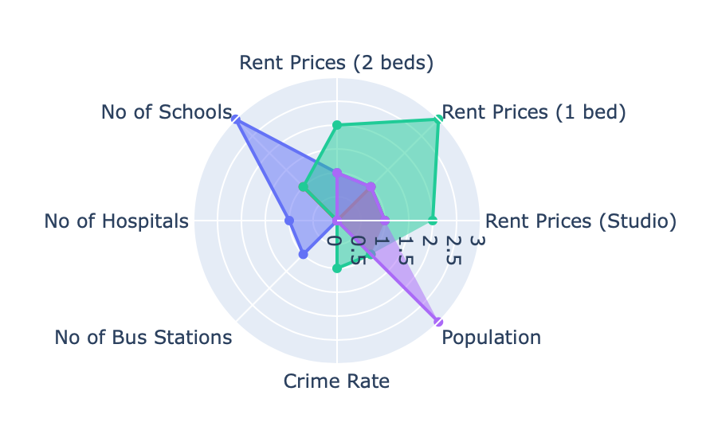
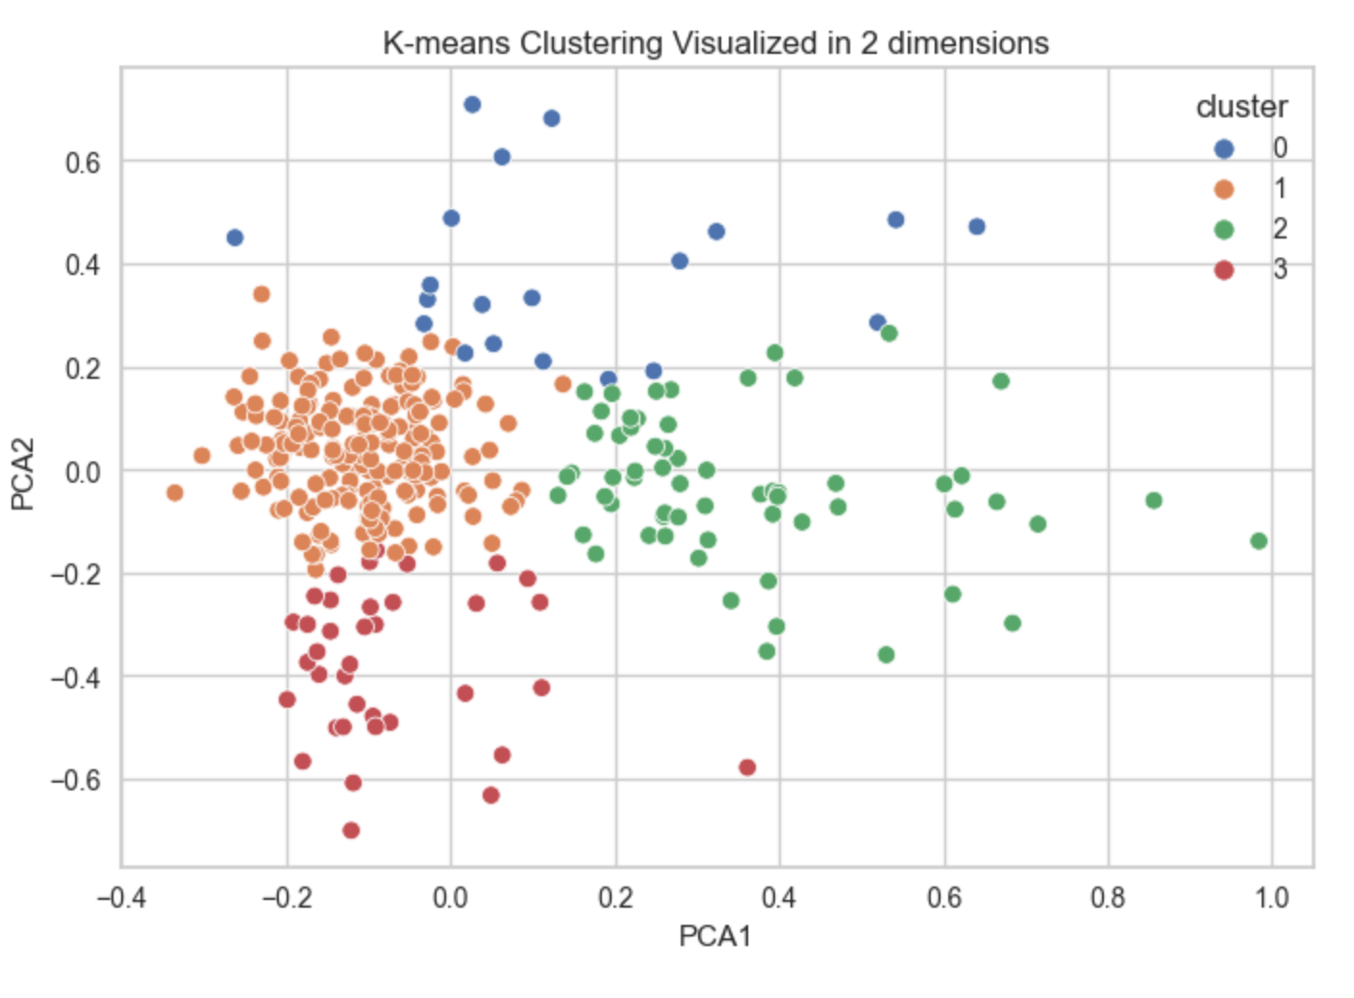
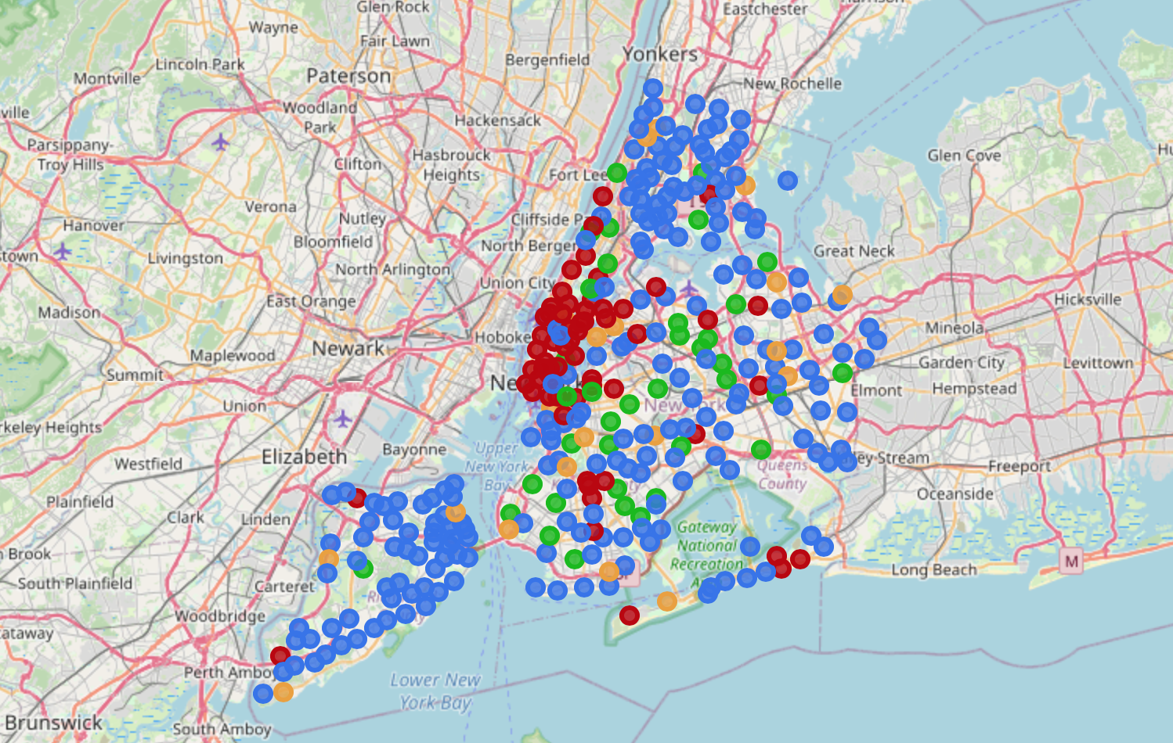
Kmeans
Neighborhood Segmentation Clustering Results

Slide 7
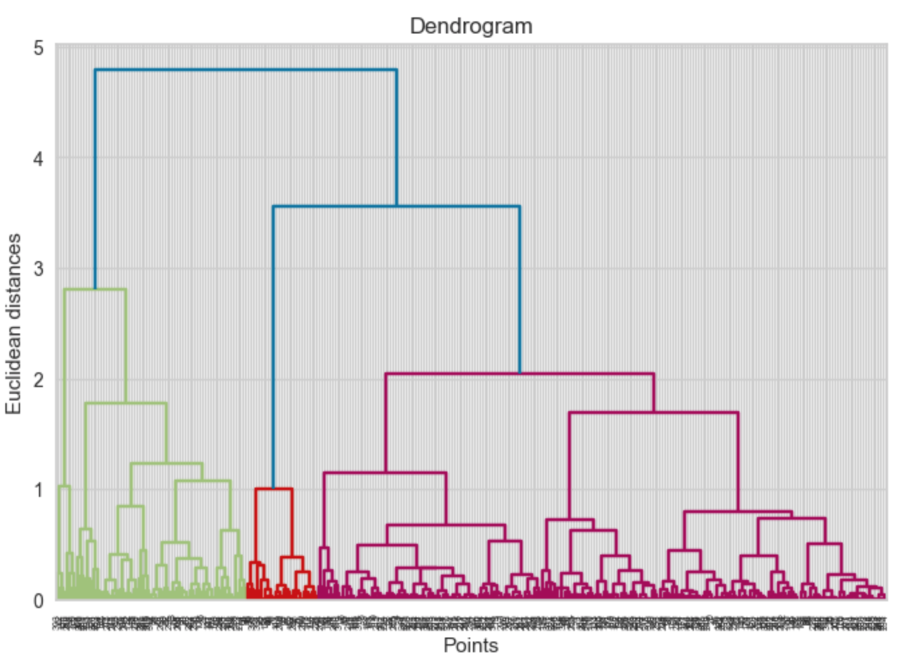
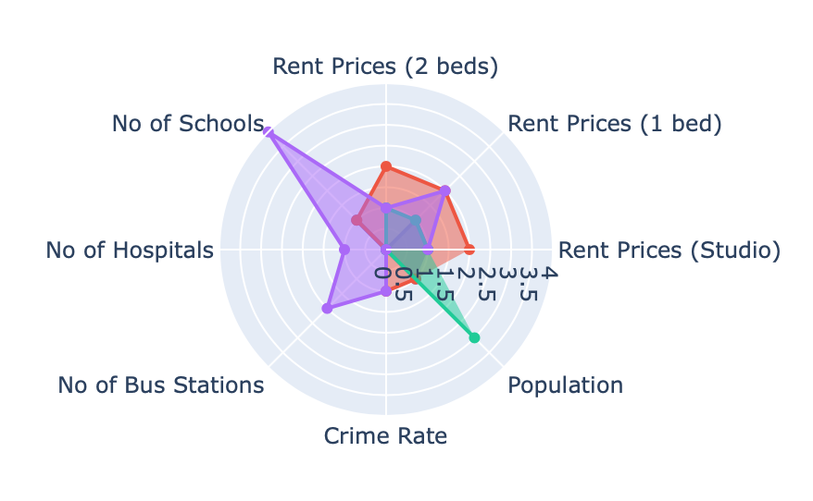
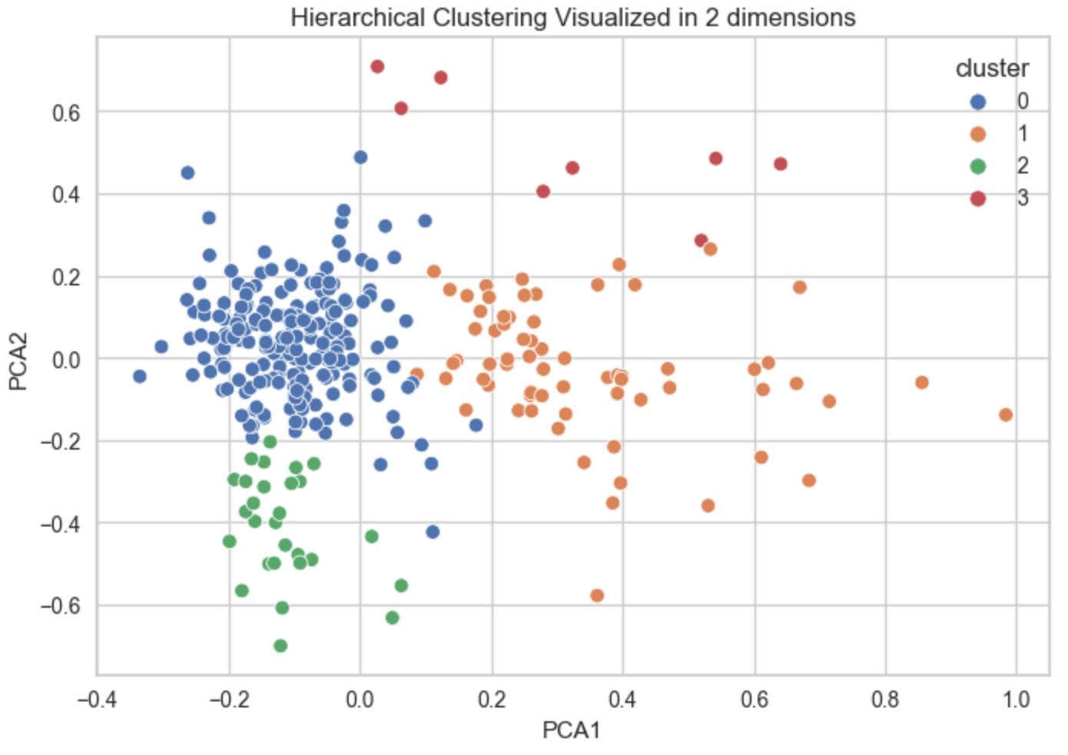
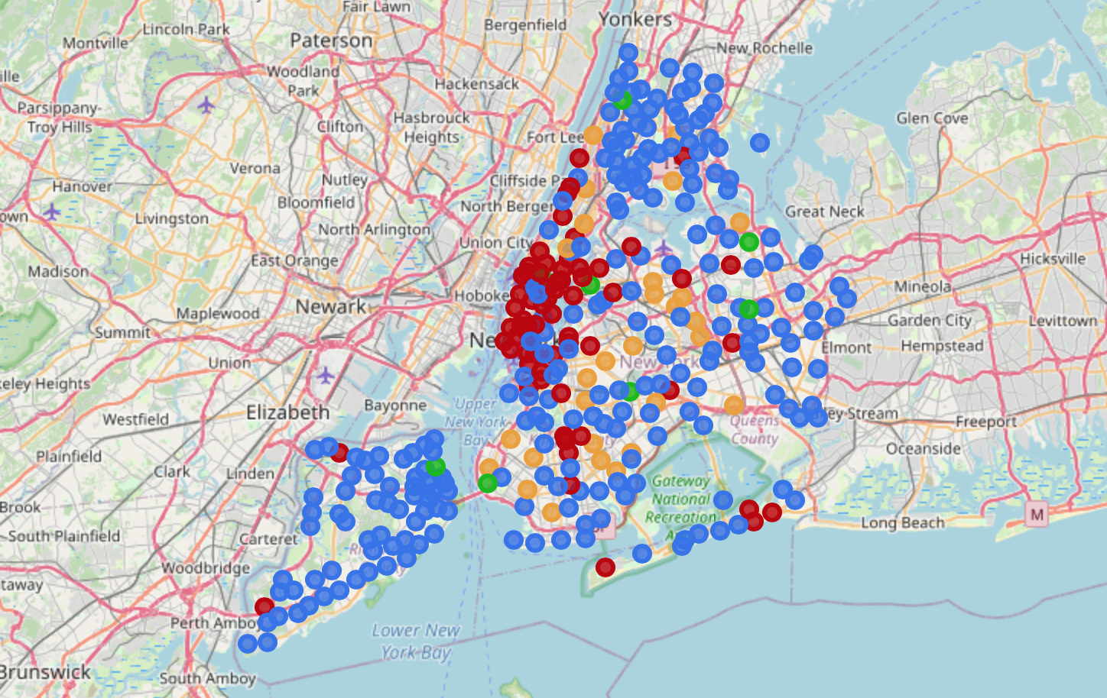
Neighborhood Segmentation Clustering Results
Hierarchical

Slide 8
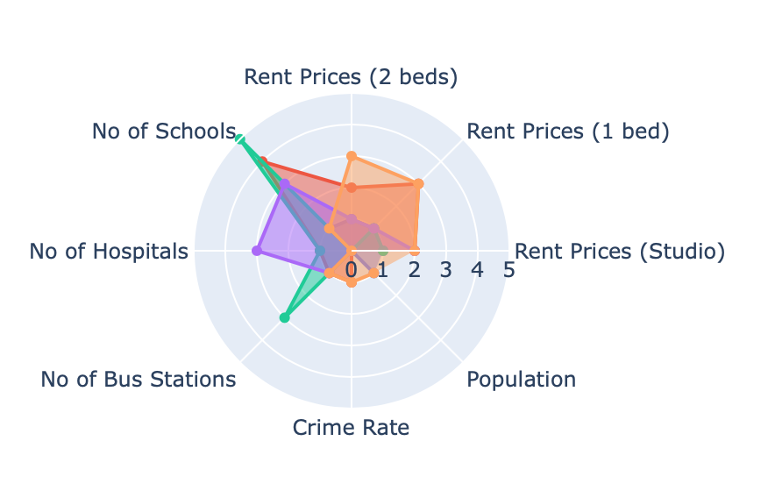
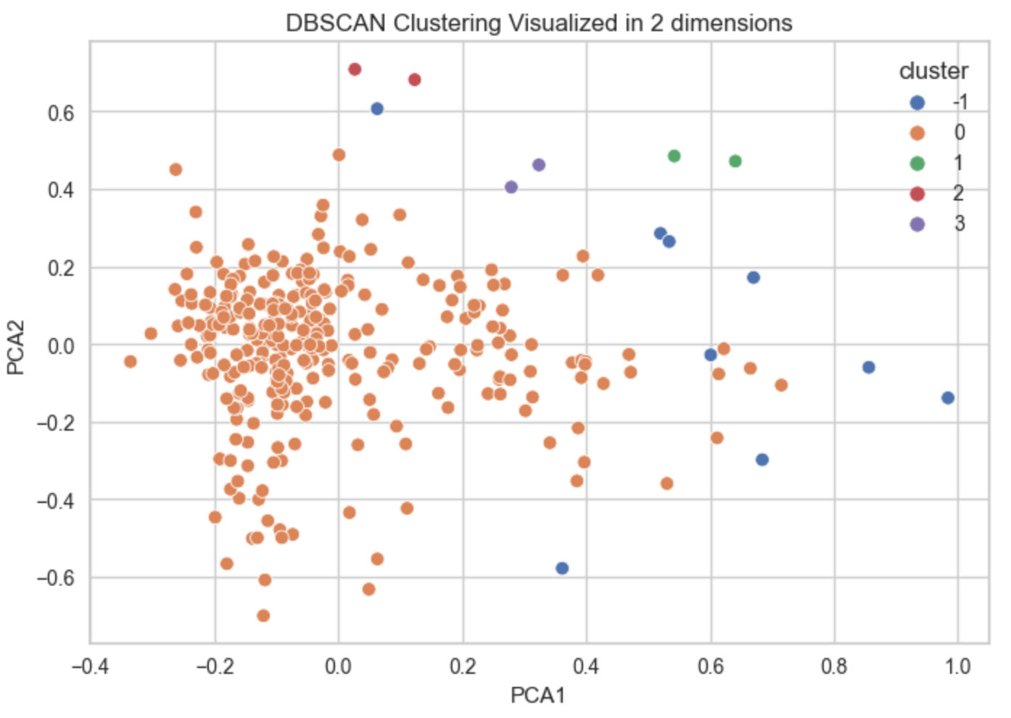
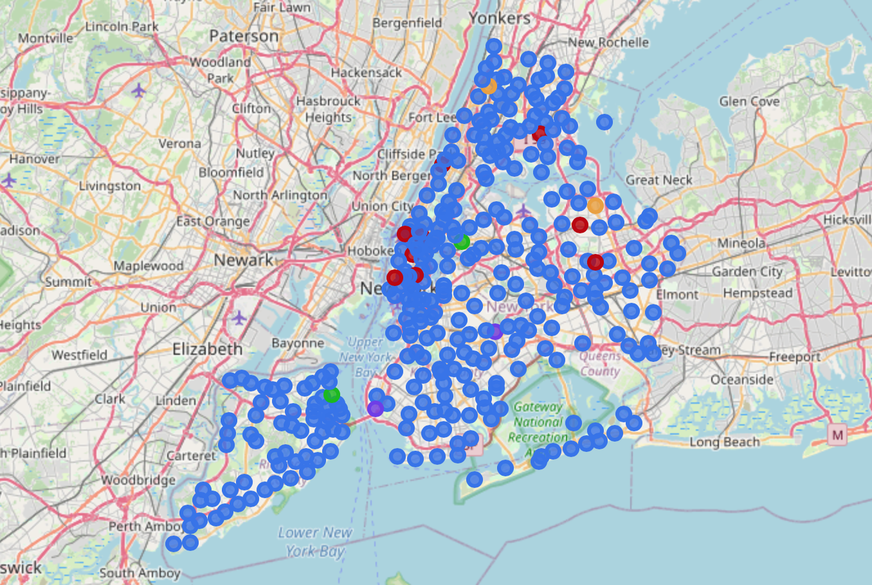
Neighborhood Segmentation Clustering Results
DBScan

Slide 9
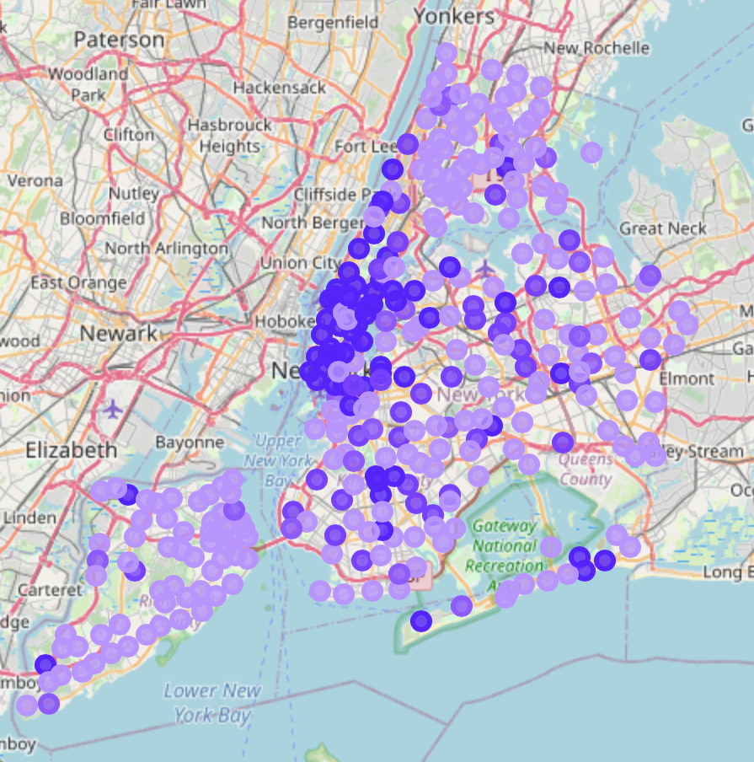
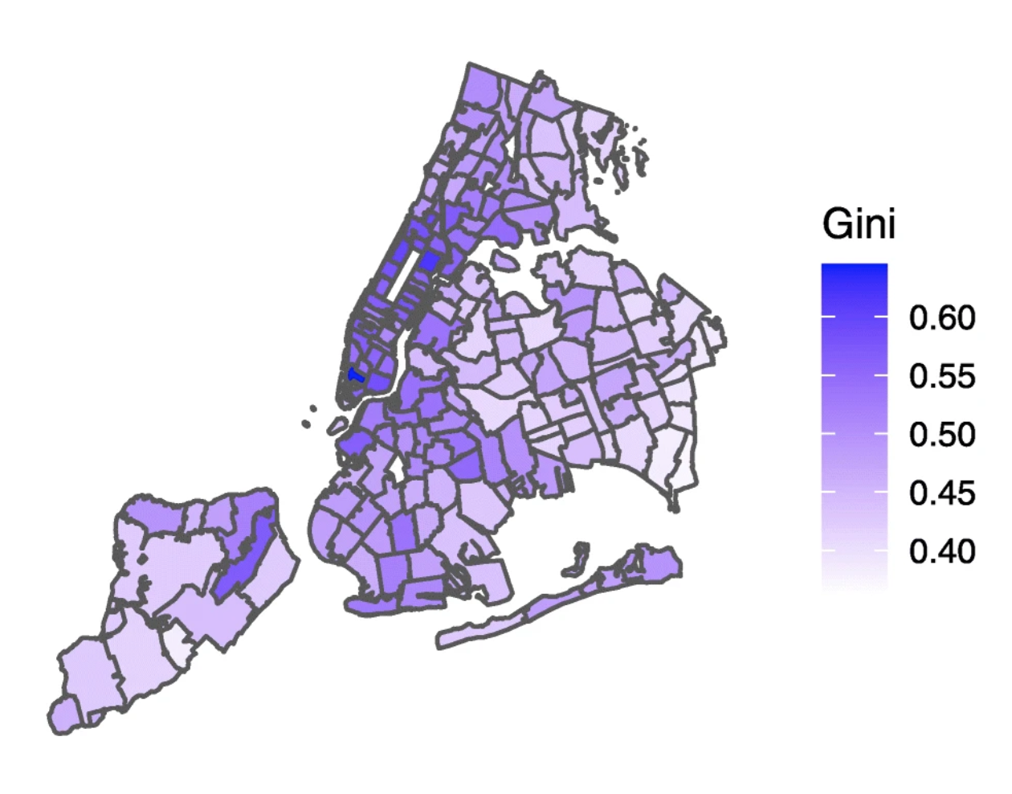
Neighborhood Segmentation Analysis
K-means Clustering
Gini Index

Slide 10
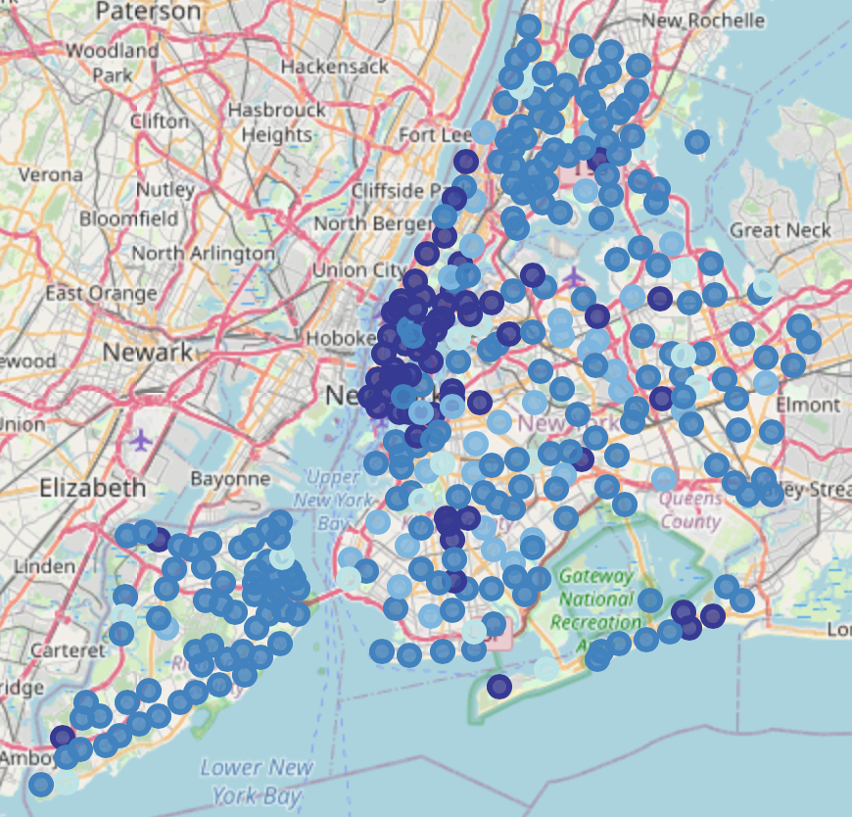
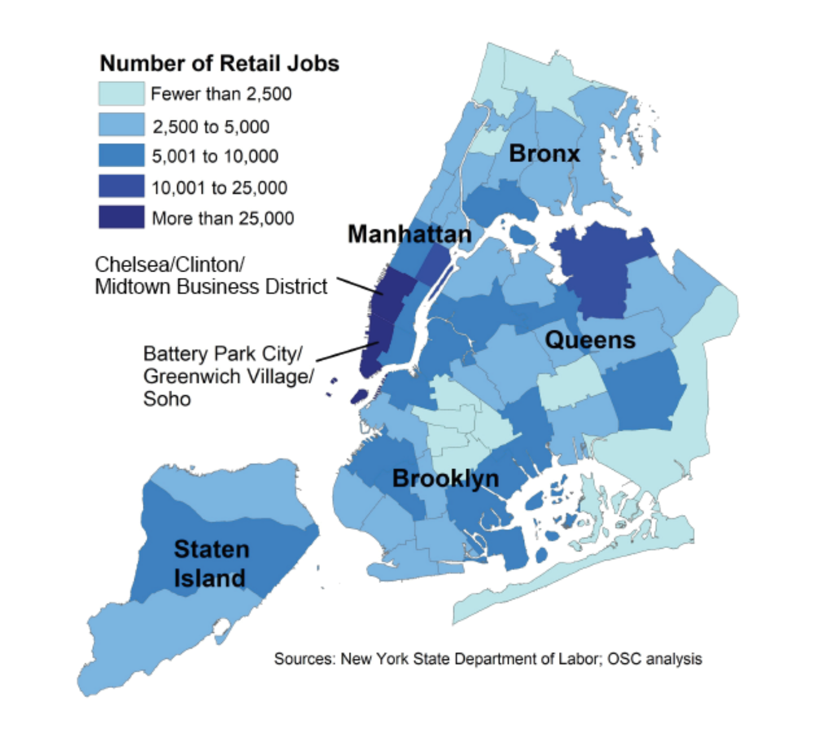
Neighborhood Segmentation Analysis
K-means Clustering
Number of Retail Jobs

Slide 11
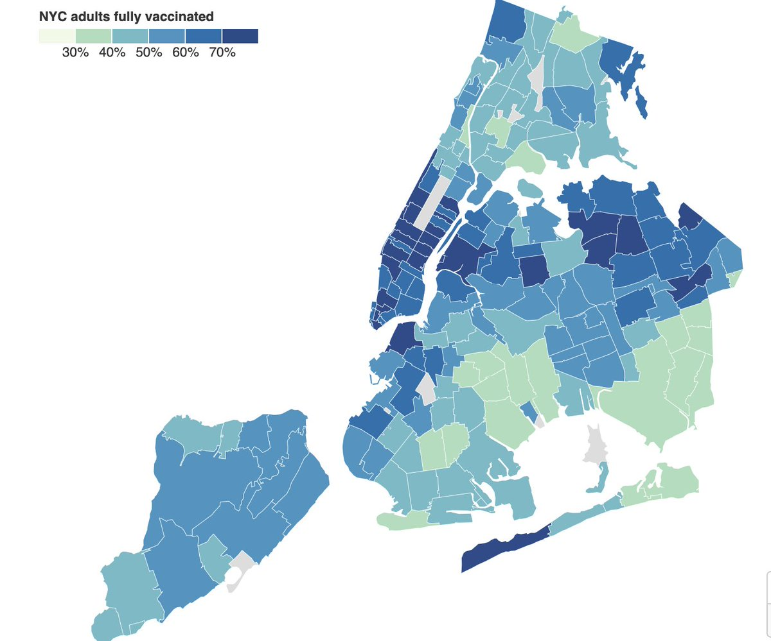
Neighborhood Segmentation Analysis
K-means Clustering
Distribution of adults fully vaccinated

Slide 12
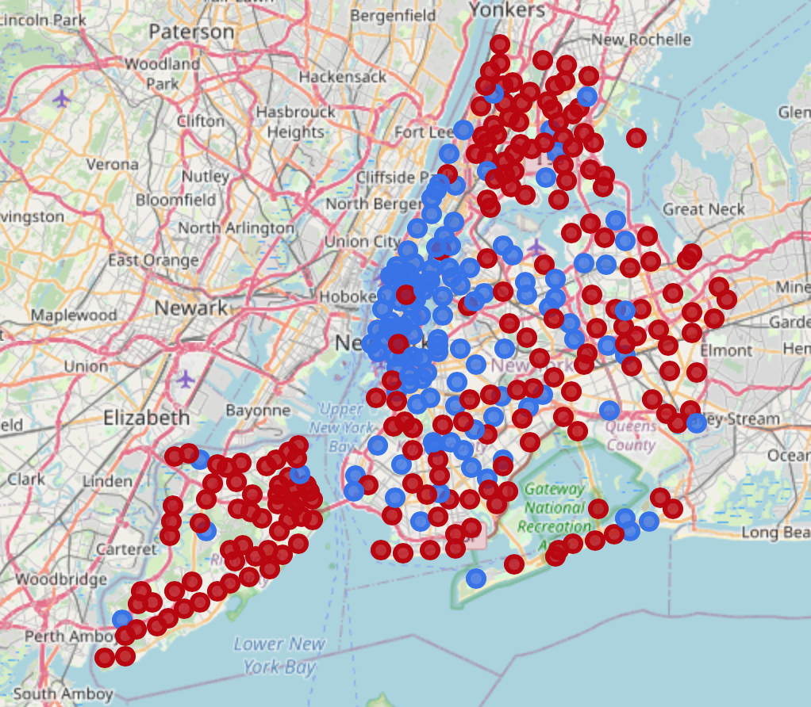
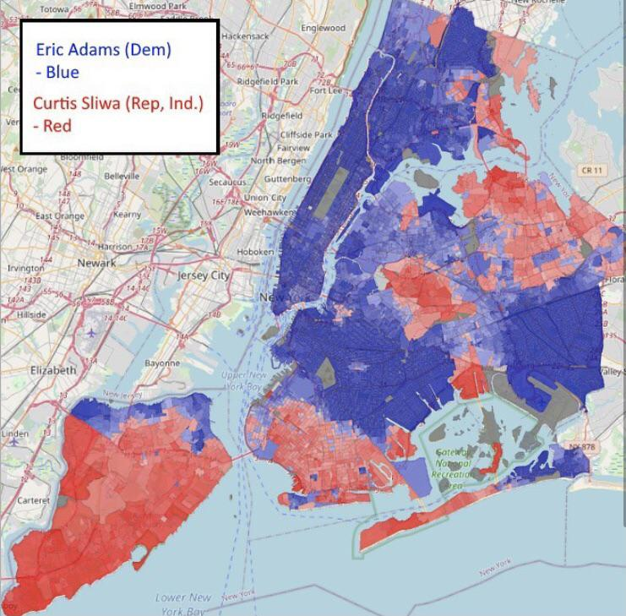
Neighborhood Segmentation Analysis
Hierarchical Clustering (2 clusters)
New York City mayoral election 2021

Slide 13
Biggest Challenges
Collaborating on git
Finding appropriate data
Data preparation
Joining mismatched, misclassified data
Features scaling
Standard Scaler VS MinMax Scaler
Silhouette Score Traps

Slide 14
Next Steps
Find and integrate financial data
Add more demographic data

Slide 15
THANK YOU FOR YOUR ATTENTION!
Michael Boddy & Siu Kei Cheung

